Slide 1
Fourth Wall
Group 26

Slide 2
Monitoring System
API
Xiaolei Zhang
Daniel Whelan
3rd year ICS
Project Manager: Product Owner
3rd year CSB
Project Manager: 1st Scrum Master
Tamunotonye Harold Karibiye
Adam Mulvihill
2nd year ICS
Developer
3rd year ICS
Project Manager: 2nd Scrum Master
Daniel Madaghijan
Haojun Xing
2nd year CSB
Developer
2nd Year ICS
Developer

Slide 3

Our Task
Our Client for this project is Finbourne Technology, Jim Ashworth and Elliot Hurdiss
Finbourne have tasked us with creating a monitoring system that will collect statistics on databases they have in Kubernetes clusters.
Currently, a “Break-Glass” procedure must be used in order to access these statistics
Our System will collect these statistics and a REST API will be used to access them, preventing Finbourne developers having to make use of this “Break-Glass” procedure.
Our goal is to minimise the frequency at which the “Break-Glass” procedure is being used and in turn make it easier for required statistics to be aggregated and examined.

Slide 4


Proposed solution
Develop monitoring system that is deployed with each database instance.
This system will poll the database and collect statistics about the database.
This information will be requested by an authenticated REST API by a Finbourne Developer.
This cuts out the requirement for “Break-Glass” to be used to view database information.

Slide 5
Functional Requirements
Develop a monitoring service that polls databases for statistics related to tables and index usage.
Include the ability to track open transactions and long running queries.
Include ability to run queries (read-only) through use of “explain analyse”
Store information collected in a separate database.
Provide access to this database via a REST API that is suitably authenticated
Provide sufficient testing of software to ensure security.

Slide 6
Non Functional Requirements
Write software using DotNet (C#)
Provide more metrics than those proposed to store in database
Create a graphical user interface for REST API
Create testing to ensure that there are no data leaks in transfer from database to API
Important for the project to have a cool name.

Slide 7
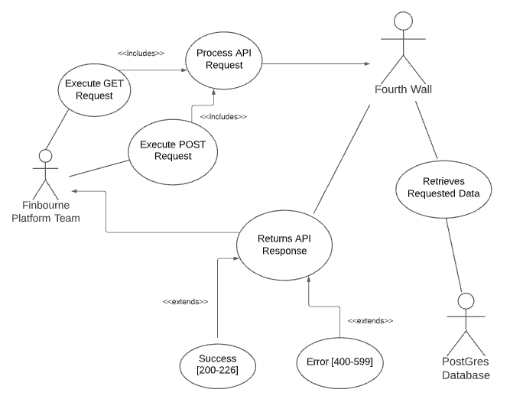
Use case diagram:

Slide 8
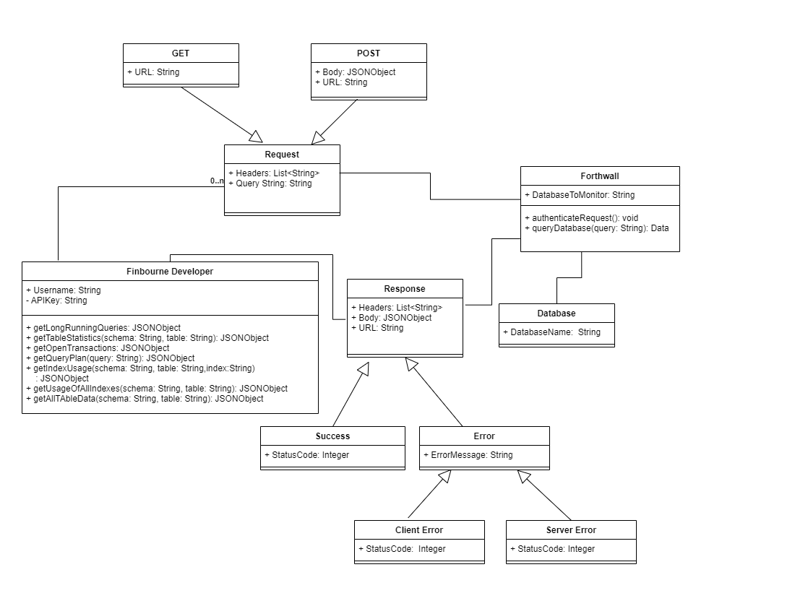
Object Model

Slide 9
Thanks For Listening!

